Slide 1
LibSat @ BCPL
Customer Satisfaction Surveys at Your Fingertips
Notes:
Introduce– running LibSat for about 6 years
How many here know about LibSat customer satisfaction survey?
How many are using it?

Slide 2
Why?
In 2007, no customer satisfaction survey since 2003.
Options:
  Paper surveys on our own
  Expensive surveys by consultant
Need for robust analysis tool
Notes:
In the past, piles of paper surveys entered into old Perseus program and analyzed with its fairly basic analysis tool. We wanted something automated with more robust analysis possibilities.
In 2007 we wanted to do another customer satisfaction survey, asked consultant who did last one.
2007 estimate for a new one: 1000 phone, 6000 paper in branches about $50,000. Lots of responses, but just a one-time snapshot.

Slide 3
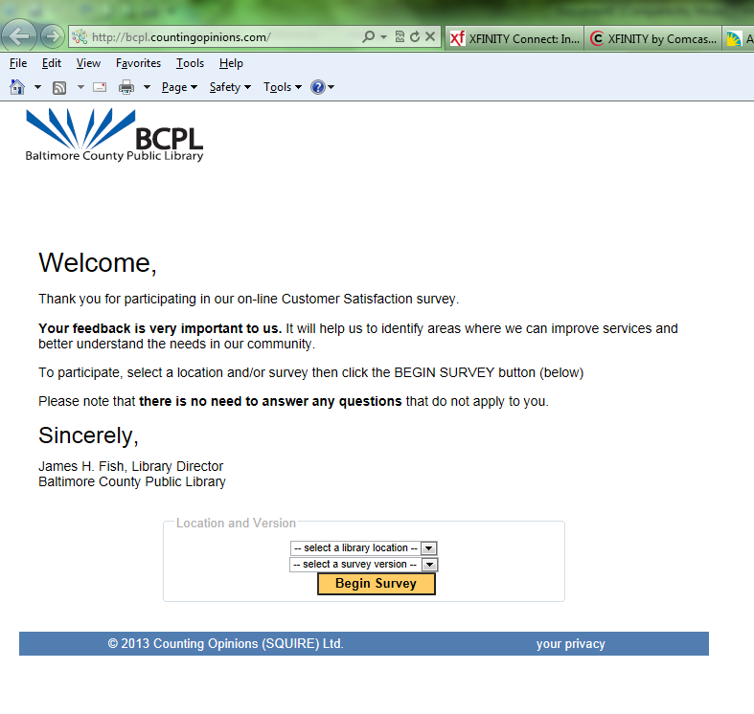
What? Counting Opinions’ LibSat
Reasonable Cost
Customized
Notes:
At ALA convention June 2007
Subscription $14,000 for 2 years, is based on population and # of outlets
A degree of customization:
You tell them your branches so the customers can select their usual branch
You tell them which surveys you want to use:
Versions: 3 lengths. We use long 15 mins. And medium 5-7 mins. About 1/3 take the long.
The surveys cover: overall, staff, facilities, collections, policies, programs, services, at different levels of detail depending on the length of the survey
There’s also a summer reading component that asks about progress, interaction, creativity, enjoyment of reading, etc. We used for a couple of years, but haven’t continued.
Languages: We use English & Spanish. Others available.
Logo etc: your logo, message from the director at the beginning

Slide 4
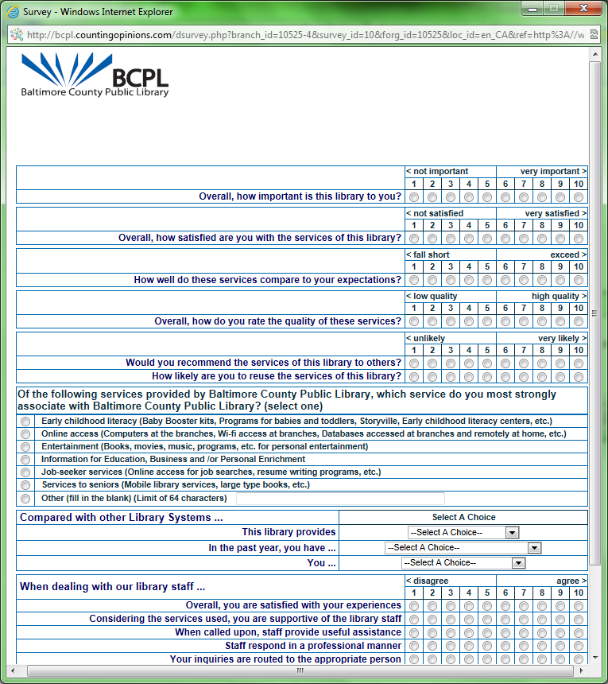
Notes:
Besides customized aspect, also standardized:
Survey questions stay the same so your library can be compared to others using it
# libraries using now: 54 public library systems with 796 locations, as well as 38 academic libraries
But, one final bit of customization, we did add a question a couple of years ago so we can at least track that question for us over time

Slide 5
How?
On your site
Marketing:
Posters in the branches
Notes:
We do it only by computer entry though you can print the surveys and have people fill them out then you enter the responses manually.
We run it for a month at a time, two times a year. You can have it available 24 x 7 x 365 if you want, the simple fact that “you continuously welcome their opinions and suggestions.” Cost doesn’t vary based on how much you use it.
They work with you on how to market and they provide sample images you can use: We use:
posters in branches telling that we’re running the survey and how to get to it,

Slide 6
More Marketing:
Notes:
static logo on library’s home page,
large pop-up window that appears to every 10 or so people who go to the home page,
and curl-down corners on the 10 must popular pages which we reevaluate every time we run the survey
SUCCESS !!! We try for about 1,000 responses each time. Have had over 11,000 responses in the 12 times we’ve run it

Slide 7
Using the Results
Measure strategic plan objectives
Respond to auditors
Gauge customers’ responses to our new efforts
Provide information for projects
Note trends in the branches
Notes:
Strategic plan objectives— the objectives are written somewhat so they can be answered by the questions on the survey. Such as
Annually, a minimum of 80% of teens and adults surveyed will indicate that they found something of interest to read, listen to, or view at the library.
Auditor questions re: competition, satisfaction, or just generally results of any customer satisfaction surveys
Gauge customer responses: We look at the comments, especially re: new things like in May re: this new branch that opened in March, next month re: our expanded hours that started this month.
Information for Projects: pull a report of all comments in related category: web site, catalog, facilities
Company’s site mentions: Benchmark and measure your library system’s “customer satisfaction” performance over time.
“customer satisfaction” information add substance to budget requests, fund raising, etc.

Slide 8
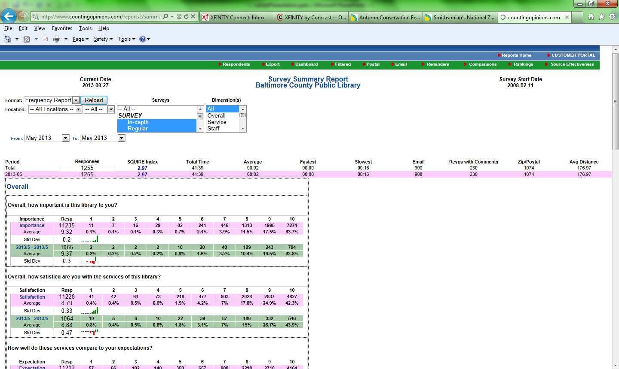
Reports
Notes:
I will show you some of the ones I use most often
There will be handouts of these reports at the breakout.
Summary Report: Frequencies– can run for any of the ‘dimensions’
This screen shot shows two of the questions, with the number of responses for each question
Shows since the beginning (in pink) and whatever period you specify such as the most recent or the surveys run during the past fiscal year (in green).
DO NOT SAY THIS UNLESS SOMEONE ASKS
[LibSat’s exclusive SQUIRE index automatically combines several customer satisfaction elements and generates a relative ranking index on both a location-specific and a system wide basis.
The index elements include:
Satisfaction, Quality, Usage, Importance, Referral and Expectation. ]

Slide 9
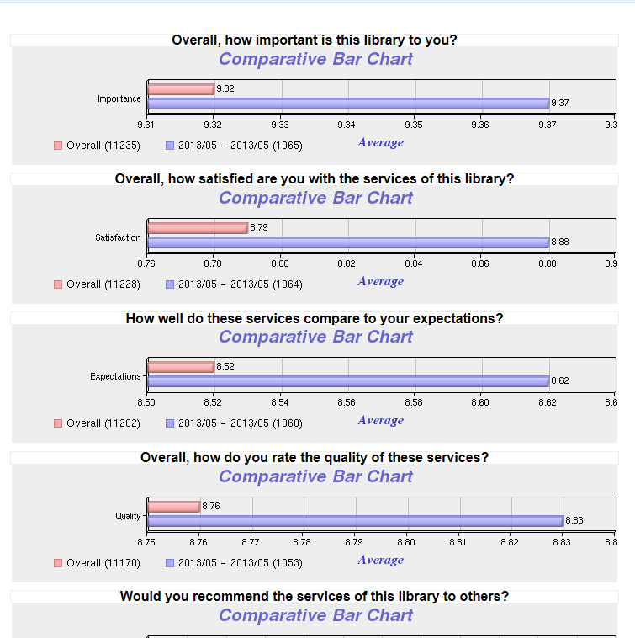
Notes:
Summary/graphs: You can also get them in graph form– you can copy/paste
And you can click on the bars and see the related comments
This shows in pink all the responses and in purple the results for the survey period you’re studying
It’s another way to show frequencies

Slide 10
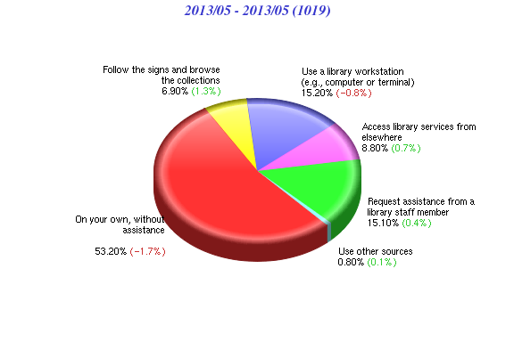
When looking for information, indicate the method you prefer ... (select the best fit)
Notes:
Some of the graphs are shown as pie charts or other formats
You can click on the pie and see the comments related to the question

Slide 11
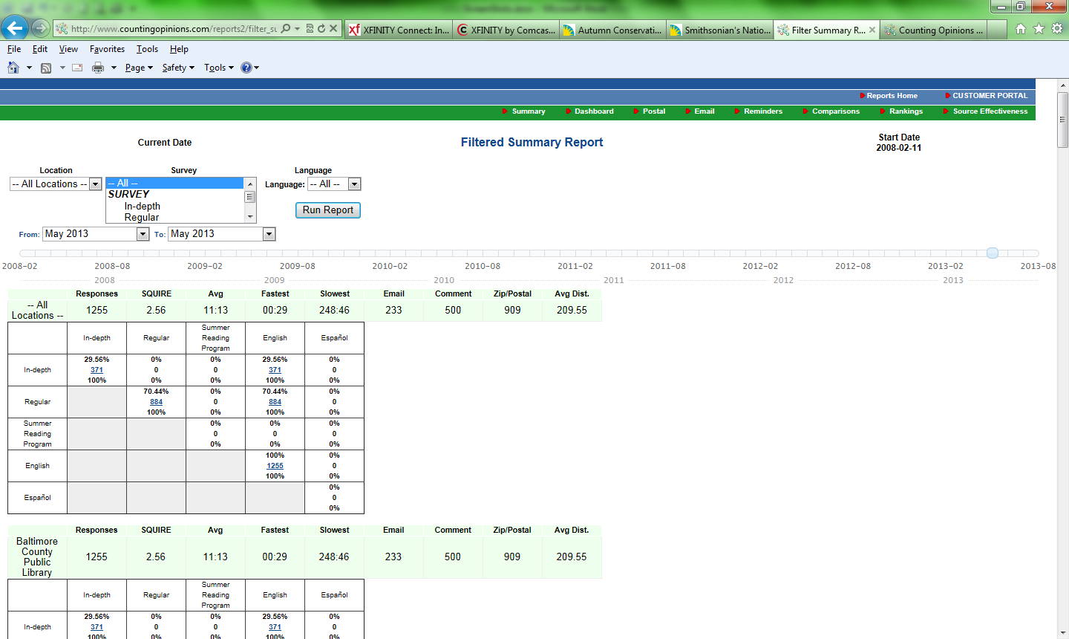
Notes:
Reports/summary/filtered—to see how many
and click on the underlined numbers to get all the comments to print and share with Irene
Are by branch so when she reads them she can see if there’s anything to be addressed at that branch

Slide 12
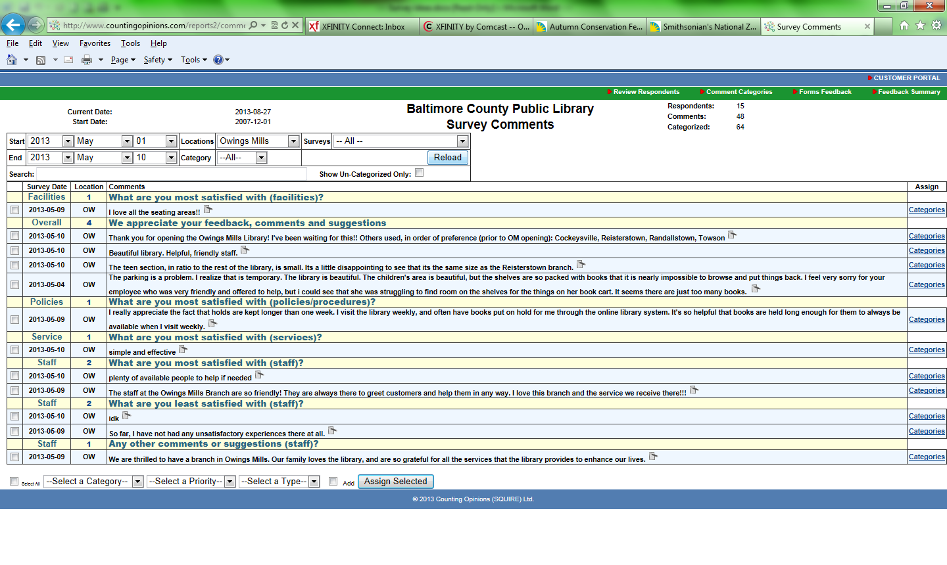
Notes:
Categorize comments– this shows all the comments for OW for the first 10 days of May, along with the questions they answered.
Third comment (Beautiful library. Helpful, friendly staff) is under general feedback, would also categorize it as staff so when look for OW comments about staff, this one will be included.

Slide 13
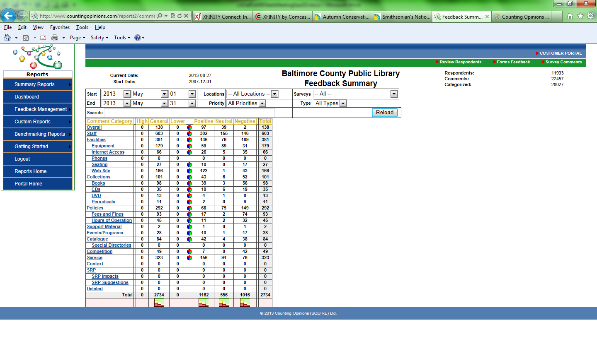
Notes:
Reports/feedback/feedback summary. Here you can see what’s covered i.e. overall, staff, facilities, collections, policies, and you can select a category or branch to print all the comments on that category for that period.
Download to Excel.

Slide 14
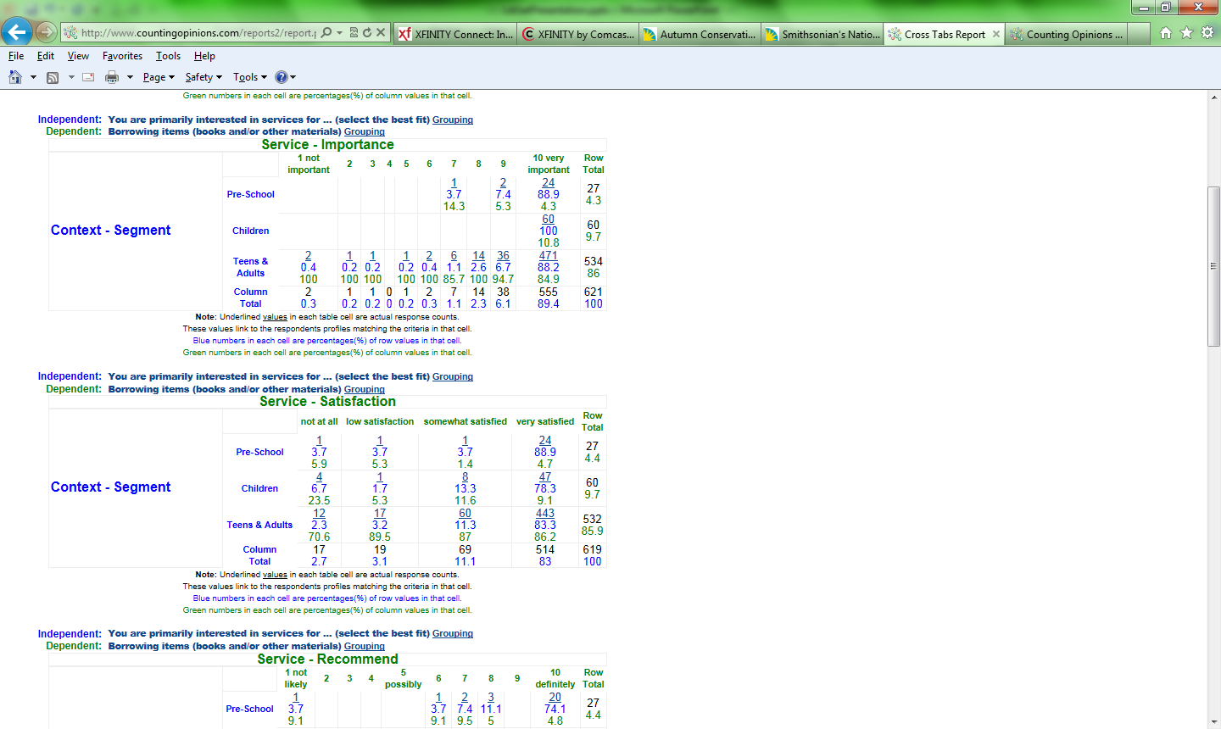
Notes:
Custom reports includes ability to run cross tab reports you build yourself.
Make the groupings of respondents and include the questions you want to show
Remember the SP objective I mentioned earlier: 80% of teens and adults surveyed will indicate that they found something of interest to read
All Survey results during FY13, grouping of teen and adult responses, grouping of 8-10 = very satisfied, and used the question that addresses borrowing items
Results = 83.3% of teens and adults were very satisfied

Slide 15
swaxter@bcpl.net
410-887-2336
www.countingopinions.com
info@countingopinions.com
Notes:
I’m happy to answer questions and refer you to them

